Slide 1
Guidelines for final projects
You must choose your teammate and your project (fill out the online survey) by 5 pm, April 29
You must submit your report and code by May 31th
Dr. Xiran Cai
caixr@shanghaitech.edu.cn
SIST Building 3-438

Slide 2
Scores
Build your team: 2-3 persons per team
Final Project: 40 points
Bonus: 1) check the requirements for the bonus in description of each project (9 point maximum); 2) subjects having less teams working on have extra bonus (Na-Ni)*3 points (9 points maximum).
Ni: No. of teams selecting project i
Na: Toltal No. of teams/4

Slide 3
Evaluation for final project
How well your method works. 50%
How clear and convincible is your presentation. 25%
How clear and complete is your report writing. 25%
• Introduction: include your motivation, background of this problem, related work of the method you adopted.
• Method and Results: clearly state each step and the outcome, use equations, flowchart or figures to help with the explanation when necessary.
• Conclusion and Discussion: is your result perfect, why? If not, why is that and how to improve?
• Please use the provided template for unifying report format. (in the folder named “Template”)
• A good example for report writing is provided (see Example-report.pdf).

Slide 4
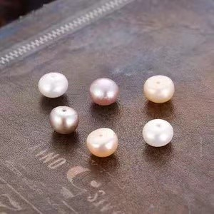
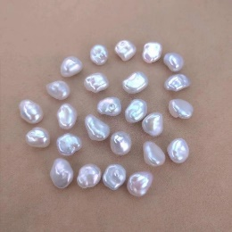
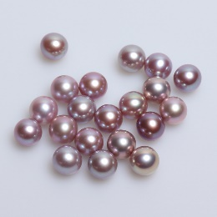
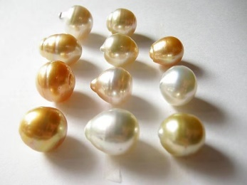
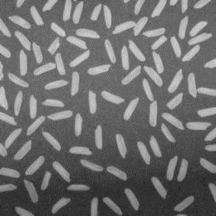
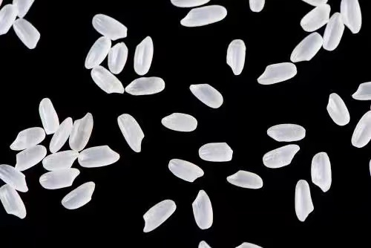






Project 1: Pearls and Rice Grains
Background: Image segmentation refers to the process of partitioning an image into multiple segments or regions, each of which corresponds to a different object or area within the image.
Goal: In this project, you will implement particle segmentation and counting with different difficulty levels.
Notes:
IoU = 真实值与预测值的交集 / 真实值与预测值的并集

Slide 5
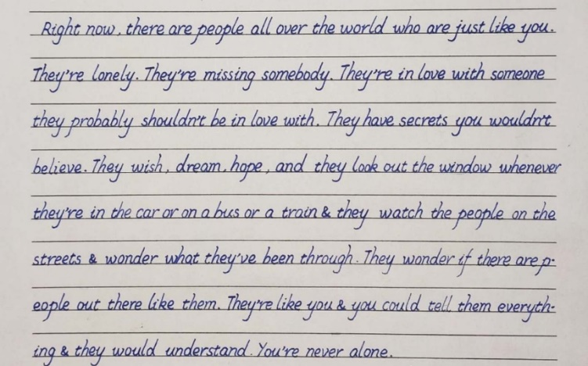
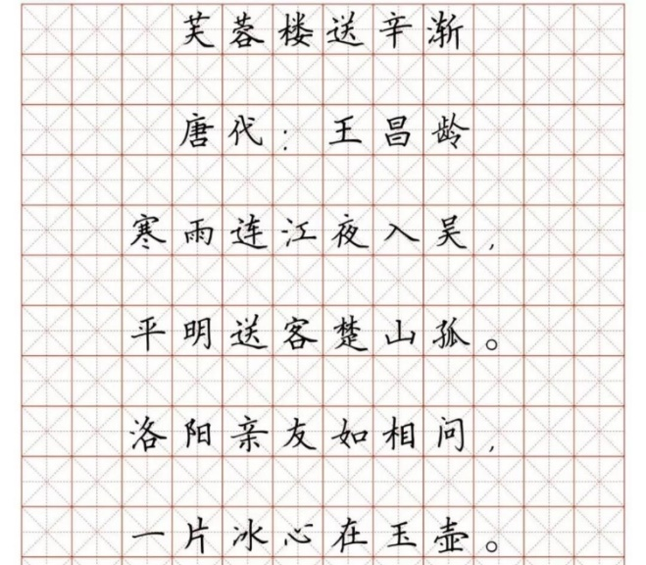
Project 2: Handwritten Text Recognition
Background: Text recognition, also known as Optical Character Recognition (OCR), is the process of converting printed or handwritten text into machine-readable format.
Goal: In this project, you will implement text recognition on handwritten text.
Expected result: “Right now there are people ……
They re lonely They ……”
(No requirement for punctuations (like “,”, “&”, “-”).)
Expected result:
“芙蓉楼送辛渐
唐代 王昌龄
寒雨连江……”
Notes:
IoU = 真实值与预测值的交集 / 真实值与预测值的并集

Slide 6
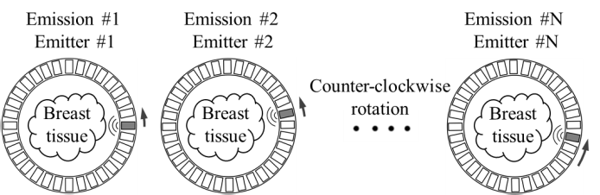
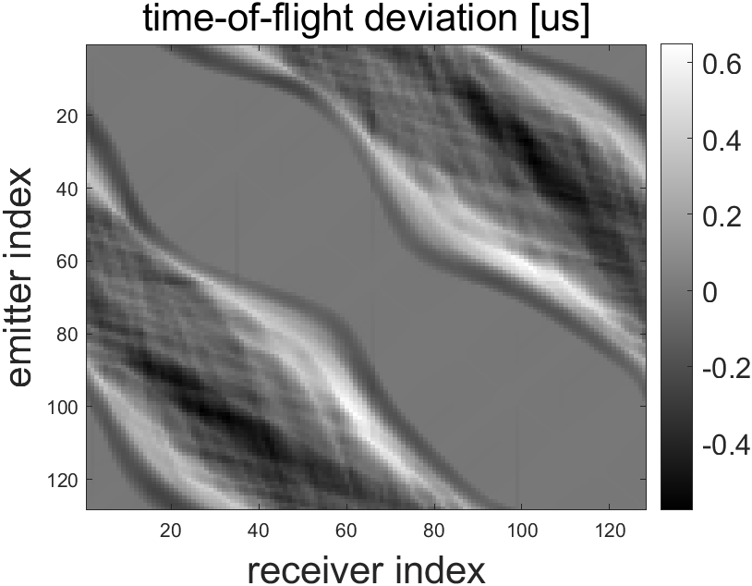
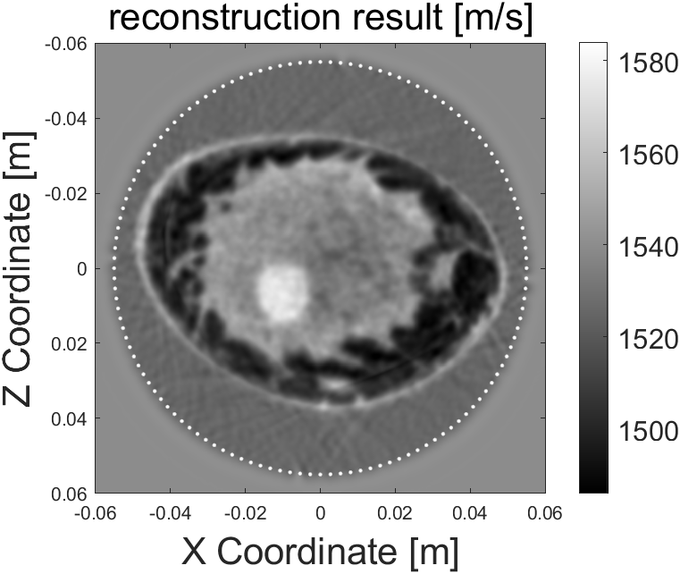
Project 3: Ultrasound Computed Tomography (USCT)
Background:
USCT is an imaging modality similar to fan beam CT
Use time-of-flight to reconstruct the speed of sound (SoS) distribution of the cross section
Yao Z, et al., IEEE Access, 2020; 8: 106832-106842
Goal:
Reconstruct the SoS image using optimization method with difference regularization terms
Build the Fresnel zone model following the instrument

Slide 7
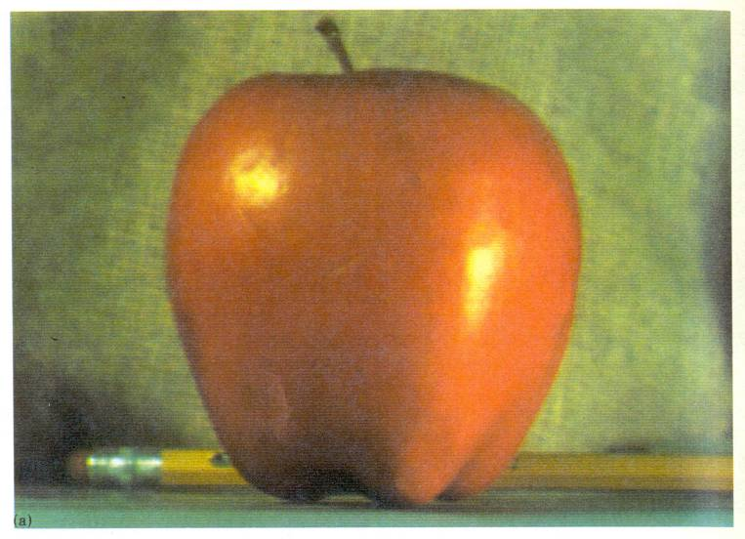
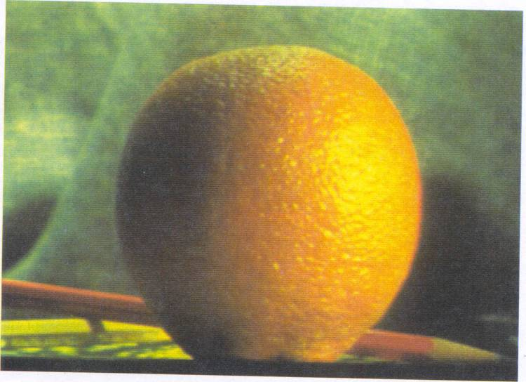
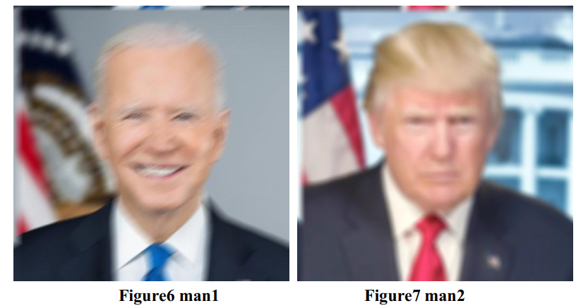
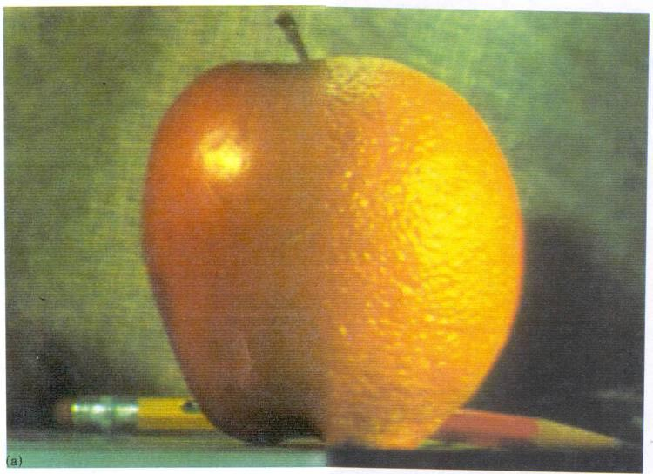
Project 4: Multi-resolution Blending
Motivation: The goal of this part of the assignment is to blend two images seamlessly using a multi resolution blending as described in the 1983 paper by Burt and Adelson. An image spline is a smooth seam joining two images together by gently distorting them. Multiresolution blending computes a gentle seam between the two images seperately at each band of image frequencies, resulting in a much smoother seam.

